Slide 1
DSI-7
Capstone Project
Optimising Customer Service
&
Operational Efficiency in the Hotel Industry
By: Vincent Kwan Wen Seng

Slide 2
Overview
Motivation
Business Impact
Data
Data Pre-Processing
+
Exploratory Data Analysis
Summary of Project Pipeline
Topic Modeling
Sentiment Analysis

Slide 3
Motivation
Industry Challenges for Hoteliers
Notes:
3 main types of CHALLENGES faced by hoteliers:
COSTS
Increasing operation costs such as:
LABOUR (rising WAGES, people don’t fancy the HECTIC + LONG HOURS +face difficult customers! ------ STB INDUSTRY ROAD MAP EMPHASIS ON MANPOWER-LEAN
MAINTENANCE – FACILITIES + UTILITIES (water/electricity)
COMPETITION:
Competitor NEXT DOOR (Hyatt / Concorde / Marriot Tangs / Hotel JEN Orchard Gateway / Rendezvous)
AirBnB
OYO Rooms/OYO Home (founded in 2013 by Ritesh Agarwal – 515k rooms as of this year)
CUSTOMER SERVICE
(most controllable! But often the most difficult!).
Hire the right staff
Train staff
Human resource allocation is key!
Managing a hotel is tough! So what can we do then?!?!
THIS IS WHERE THE REAL FOCUS OF MY PROJECT LIES

Slide 4
Motivation
Can Data Science empower hoteliers with the ability to quantify customer satisfaction?
Can it help to optimise customer service delivery & allow managers to focus on areas where it matter most?
Notes:
Can we use hotel reviews to gauge how happy/unhappy customers were?
Are customer service levels maintained at a high standard or has complacency kicked in in recent times?
Can we know from customer reviews what are the major concerns customers have? Are there patterns?
And if a change is implemented, can we sort of have a feel of whether things are going well?

Slide 5
Motivation
Hotel Manager
F&B
Customer Service
Room Operations
Notes:
Here is what generic operational structure of hotel management team could look like
Hotel manager is responsible in 3 broad areas 1. F&B / 2. Customer Service in general / 3. Operations (room service/facility management)
DELEGATION is key for a good hotel manager. Each team does their job to the fullest. Often we find that due to manpower issues, staff have to do several things at once with no real focus of what really matters

Slide 6
Business Impact
Remove man-hours required to process thousands of reviews across different sites
Facilitate business units in decision-making
Quantify customers’ satisfaction. Maintain quality customer service
Improve customer experience by addressing concerns effectively & in good time
Notes:
What impact will my NLP project have?
1. Not practical for employee to go through all reviews across many review sites and digest everything
2. Stars on review sites can be subjective and may not be a good indicator of real sentiment (Asians are usually more critical/fussy than Europeans)
3. Hotel manager and team lead would be able to make better decisions if they know what needs to be prioritized
4. Burning concerns (bed bug/restaurant standards) can be attended to quickly

Slide 7
Natural Language Processing:
Sentiment Analysis
+
Topic Modeling

Slide 8
Dataset

Slide 9
The Dataset (Mandarin Orchard Hotel)
Python Web Scraping – BeautifulSoup, Xpath, Selenium
Observations
Features
Reviews & Dates
Hotel’s Response
Purpose of Stay
Reviewer’s Nationality
20K
7
Notes:
TripAdvisor: data from 2003
Agoda: data from 2008
Why use data from 2010 onwards / Why this hotel?
Hotel went through major transformation in 2009, completely changing the façade of lobby and adding a shopping mall underneath it.
Some problems that came with it includes the fact that it is now a little confusing to navigate around the hotel.
But some facilities renovated. It is a super old hotel with history which dates back to 1970s

Slide 10
Data Pre-processing
&
Exploratory Data Analysis

Slide 11
Data Pre-processing
Punctuations & Special Characters
Non-English Words
Stop Words
Lemmatization
Notes:
Date Formatting: Not consistent on both data sources
Stop Words: Remove standard + Custom stopwords (during iterative process)
Lemmatization Using SpaCy: Better than stemming as I want to avoid losing information

Slide 12
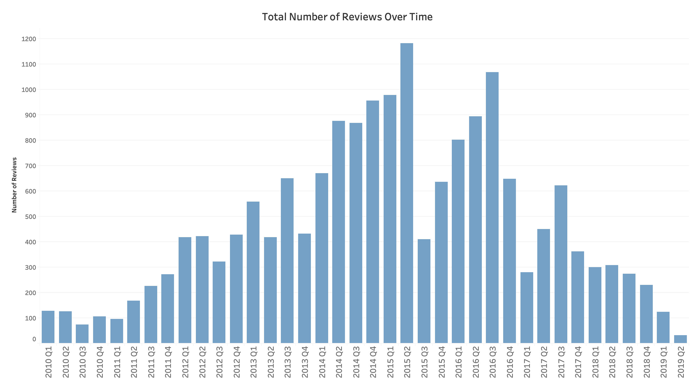
Exploratory Data Analysis
No. of Clean Reviews
~18K
Notes:
17789 rows remain after using data from 2010
THIS DOES NOT INDICATE THE ACTUAL NUMBER OF CUSTOMERS STAYING AT HOTEL OVER TIME
Number of reviews posted was on the rise from 2010 to mid-2015, dropping as we move towards 2019.

Slide 13
Exploratory Data Analysis
Leisure
Business
74%
26%
Notes:
As expected because the hotel positioned itself to cater mostly for tourists who travel for leisure

Slide 14
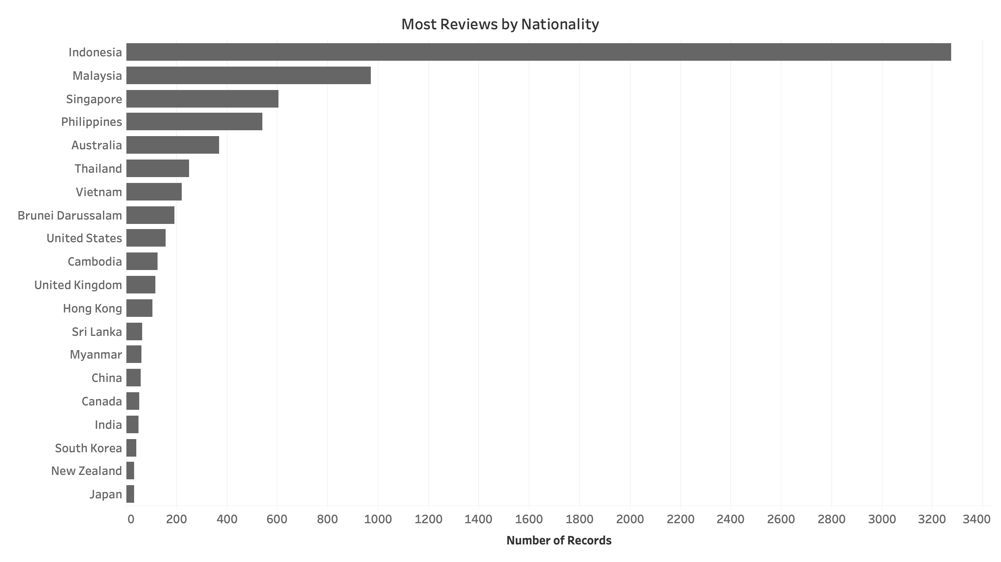
Exploratory Data Analysis
Notes:
Majority ASEAN countries! + Singaporeans as well (we love staycations?)
A LOT of Indonesians. Yes, Singapore do have lots of Indonesian visitors and perhaps the hotel’s roots linking to Lippo Group (Riady Family) reputation played a part.

Slide 15
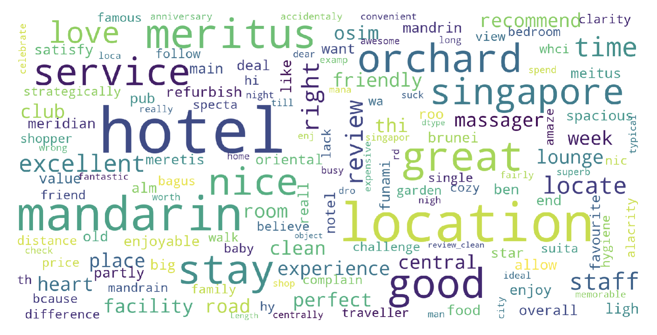
Exploratory Data Analysis
Notes:
POSITIVES:
Location + Shopping + Orchard + Convenient: People seem to mention a lot about it. Perhaps being located at the heart of Orchard road really appeals to travelers.
Service + Staff + Friendly: Good or maybe Bad?
Price + Value
Room + Spacious + Clean
Facilities + Lounge + club + Garden + Massage + Osim? Are there massage chairs around that people can use for free?!?!
NEGATIVES:
Sucks
Expensive
Lack

Slide 16
Sentiment Analysis

Slide 17
Sentiment Analysis
TextBlob
VADER - (Valence Aware Dictionary and sEntiment Reasoner)

Slide 18
Sentiment Analysis
VADER
+ve: 15654 (88%)
Neutral: 366 (2%)
-ve: 1778 (10%)
Tolerance of Bad Review can be adjusted

Slide 19
Sentiment Analysis
“UNorganised, old + dilapidated hotel. LOUSY ! Stayed in this hotel for a night and then moved to Hyatt which is just down the road and about 50 dollar more. It worth every penny at the hyatt. The meritius mandarin looked so old and the toilet they have is DISGUSTING. The flooring and the marble furnished they have are old and looks uncleaned, and this is at the "premier room" , whic i paid $340 sing ++ for one night. Terrible, the hotel is so un-organized, you will have to go through a set of shops before getting on the set of lifts that took me to my room. Absolutely rubbish and very poor management, the environment made me feels that i am in a FLEA market rather than a 5 star hotel. If you are thinking to stay in Orchard Road, pick either Marriot or Hyatt. They are both way better !”
TextBlob: -0.1
VADER: -0.9

Slide 20
Topic Modeling

Slide 21
Topic Modeling
Latent Dirichlet Allocation (LDA)
Hidden
A Type of Probability Distribution

Slide 22
Topic Modeling
Latent Dirichlet Allocation (LDA)
Input:
Dictionary of Tokens
Document Term Matrix (BoW)
Part-of-Speech: SpaCy Nouns Only
Stop Words: SpaCy + Custom
Lemmatization: SpaCy
3.
Number of Topics: 3 to 6
Passes: 100, 250, 500
Ngrams: Unigram
Output:
Each document (review) is assigned a set of probabilities of whether it belongs to topic 1, 2, 3,…, k

Slide 23
Topic Modeling
Latent Dirichlet Allocation (LDA)
How to evaluate?
Coherence (‘u_mass’)
Interpret
Visualise (pyLDAViz)
Notes:
coherence. This metric measures whether the words in a topic tend to co-occur together. We add up a score for each distinct pair of top ranked words. The score is the log of the probability that a document containing at least one instance of the higher-ranked word also contains at least one instance of the lower-ranked word.

Slide 24
Topic Modeling
Topic 1: Customer Svc/Check-in/Reception
Room, check, time, staff, service, guest, hour, luggage, stay, reception
Topic 2: Room
Room, bed, bathroom, floor, shower, stay, water, service, tower, wing
Topic 3: F&B/Breakfast
Breakfast, staff, service, room, food, stay, club, time, buffet, restaurant
Topic 4: Shopping/Restaurants/Location
Shopping, room, mall, place, staff, food, restaurant, area, heart, service
Coherence = -2.456
Notes:
VIZ
Distance between circles = difference of the semantic relationship of topics
Hover over words – can see freq of it appearing in other topics

Slide 25
Summary of Project Pipeline
Sentiment Analysis
Topic Modeling

Slide 26
Dashboard

Slide 27
Limitations
VADER Sentiment Analysis
Does the job but not exactly state-of-the-art
For this dataset, it tends to over-rate sentiments at the positive end
Lexicon-based (order doesn’t matter)– will struggle on figure-of-speech
Topic Modeling (LDA)
May incorrectly assign topics for short documents (probabilistic)

Slide 28
Other Business Applications
E-commerce Product Reviews
On-site Customer Service Feedback
Financial Market Prediction
Notes:
E-commerce:
- Learn how its customers are reacting to its products and services
- Detect changes in its customers’ cultural and technological landscapes that are affecting what its customers are looking for and how

Slide 29
Next Steps
“MY SPEELLING SUCCKS!”
DATA PRE-PROCESSING
TextBlob:
Spelling Correction
Translate non-English words
TRY ADVANCED MODELS
Sentiment Analysis:
Stanford NLP (pre-trained)
Topic Modelling:
Deep-Learning Word-Embedding Models
‘Mother of All Models’
Build one that can generalise for entire hotel industry

Slide 30
Thank You!

